Slide 2
Burp Suite is a framework written in Java that aims to provide a one-stop-shop for web application penetration testing. In many ways, this goal is achieved as Burp is very much the industry standard tool for hands-on web app security assessments. Burp Suite is also very commonly used when assessing mobile applications, as the same features which make it so attractive for web app testing translate almost perfectly into testing the APIs (Application Programming Interfaces) powering most mobile apps.
Whilst Burp Community limited feature
Proxy: The most well-known aspect of Burp Suite, the Burp Proxy allows us to intercept and modify requests/responses when interacting with web applications.
Repeater: The second most well-known Burp feature -- Repeater -- allows us to capture, modify, then resend the same request numerous times. This feature can be absolutely invaluable, especially when we need to craft a payload through trial and error (e.g. in an SQLi -- Structured Query Language Injection) or when testing the functionality of an endpoint for flaws.
Intruder: Although harshly rate-limited in Burp Community, Intruder allows us to spray an endpoint with requests. This is often used for bruteforce attacks or to fuzz endpoints.
Decoder: Though less-used than the previously mentioned features, Decoder still provides a valuable service when transforming data -- either in terms of decoding captured information, or encoding a payload prior to sending it to the target. Whilst there are other services available to do the same job, doing this directly within Burp Suite can be very efficient.

Slide 3
Comparer: As the name suggests, Comparer allows us to compare two pieces of data at either word or byte level. Again, this is not something that is unique to Burp Suite, but being able to send (potentially very large) pieces of data directly into a comparison tool with a single keyboard shortcut can speed things up considerably.
Sequencer: We usually use Sequencer when assessing the randomness of tokens such as session cookie values or other supposedly random generated data. If the algorithm is not generating secure random values, then this could open up some devastating avenues for attack.
Free extension: https://github.com/portswigger/logger-plus-plus

Slide 4
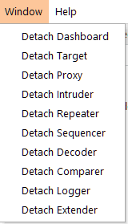
Navigation
Tabs can also be popped out into separate windows should you prefer to view multiple tabs separately. This can be done by clicking "Window" in the application menu at the top of the screen, then choosing to "Detach" tabs:
Ctrl + Shift + D | Switch to the Dashboard
Ctrl + Shift + T | Switch to the Dashboard
Ctrl + Shift + P | Switch to the Proxy tab
Ctrl + Shift + I | Switch to the Intruder tab
Ctrl + Shift + R | Switch to the Repeater tab

Slide 5
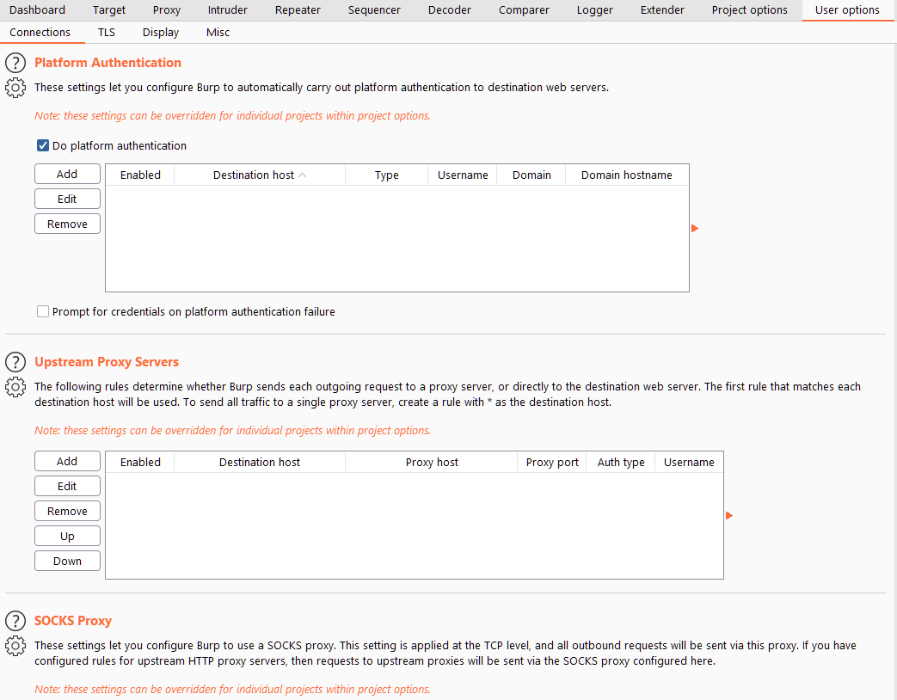
Before we start learning about the Burp Proxy, let's take a look at the options available for configuring Burp Suite.
Global settings can be found in the User options tab along the top menu bar.
Project-specific settings can be found in the Project options tab.

Slide 6
There are four main sub-sections of the User options tab:
The options in the Connections sub-tab allow us to control how Burp makes connections to targets. For example, we can set a proxy for Burp Suite to connect through; this is very useful if we want to use Burp Suite through a network pivot.
The TLS sub-tab allows us to enable and disable various TLS (Transport Layer Security) options, as well as giving us a place to upload client certificates should a web app require us to use one for connections.
An essential set of options: Display allows us to change how Burp Suite looks. The options here include things like changing the font and scale, as well as setting the theme for the framework (e.g. dark mode) and configuring various options to do with the rendering engine in Repeater (more on this later!).
The Misc sub-tab contains a wide variety of settings, including the keybinding table (HotKeys), which allowing us to view and alter the keyboard shortcuts used by Burp Suite. Familiarising yourself with these settings would be advisable, as using the keybinds can speed up your workflow massively.
Let's move on to look at the project-specific configurations available in the Project options tab

Slide 7
Connections holds many of the same options as the equivalent section of the User options tab: these can be used to override the application-wide settings. For example, it is possible to set a proxy for just the project, overriding any proxy settings that you set in the User options tab. There are a few differences between this sub-tab and that of the User options, however. For example, the "Hostname Resolution" option (allowing you to map domains to IPs directly within Burp Suite) can be very handy -- as can the "Out-of-Scope Requests" settings, which enable us to determine whether Burp will send requests to anything you aren't explicitly targeting (more on this later!).
The HTTP sub-tab defines how Burp handles various aspects of the HTTP protocol: for example, whether it follows redirects or how to handle unusual response codes.
TLS allows us to override application-wide TLS options, as well as showing us a list of public server certificates for sites that we have visited.
The Sessions tab provides us with options for handling sessions. It allows us to define how Burp obtains, saves, and uses session cookies that it receives from target sites. It also allows us to define macros which we can use to automate things such as logging into web applications (giving us an instant authenticated session, assuming we have valid credentials).
There are fewer options in the Misc sub-tab than in the equivalent tab for the "User options" section. Many of the options here are also only available if you have access to Burp Pro (such as those configuring Collaborator). That said, there are a couple of options related to logging and the embedded browser (which we will look at in a couple of tasks) that are well worth perusing.

Slide 8
Introduction to the Burp Proxy

Slide 9
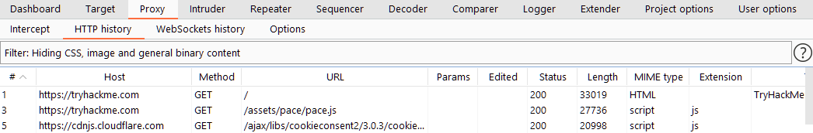
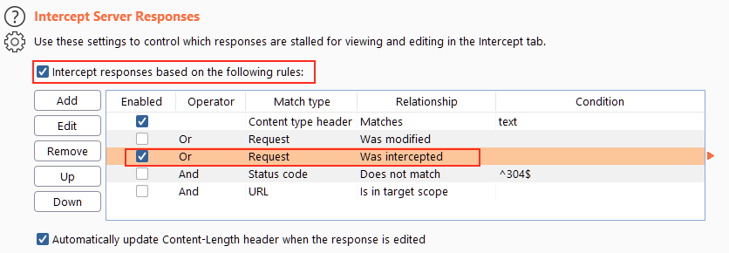
It allows us to capture requests and responses between ourselves and our target. These can then be manipulated or sent to other tools for further processing before being allowed to continue to their destination.
For example, the proxy will not intercept server responses by default unless we explicitly ask it to on a per-request basis. We can override the default setting by selecting the "Intercept responses based on the following rules" checkbox and picking one or more rules. The "Or Request Was Intercepted" rule is good for catching responses to all requests that were intercepted by the proxy:
The "And URL Is in target scope" is another very good default rule; we will look at scoping later in this room.

Slide 10
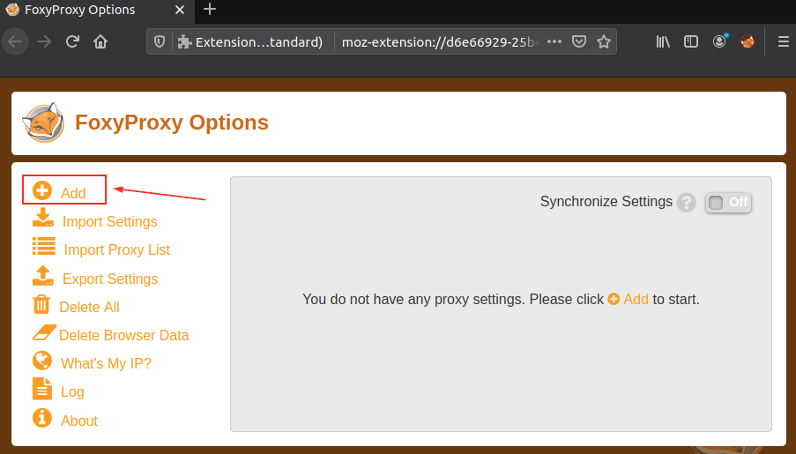
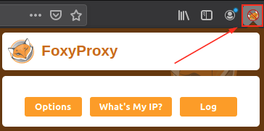
Installing ProxyFoxy extension:
Add-on-→ extention

Slide 11
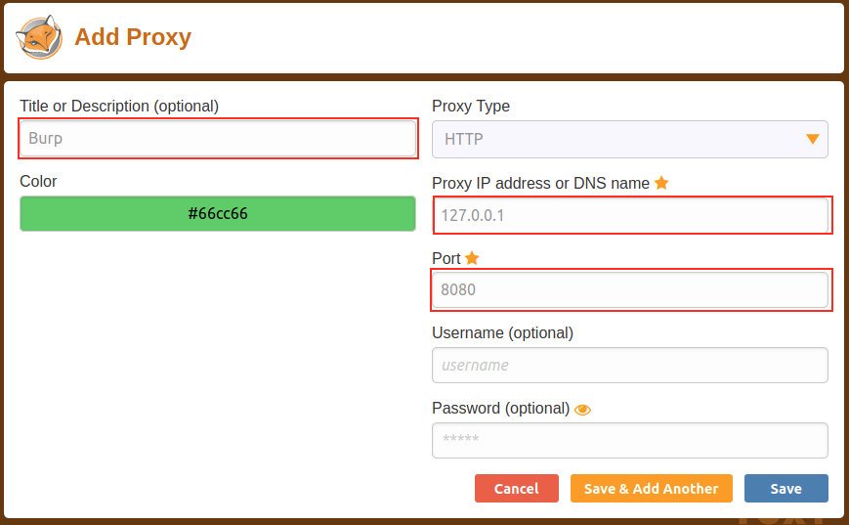
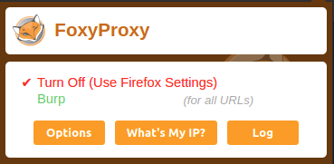

Slide 12
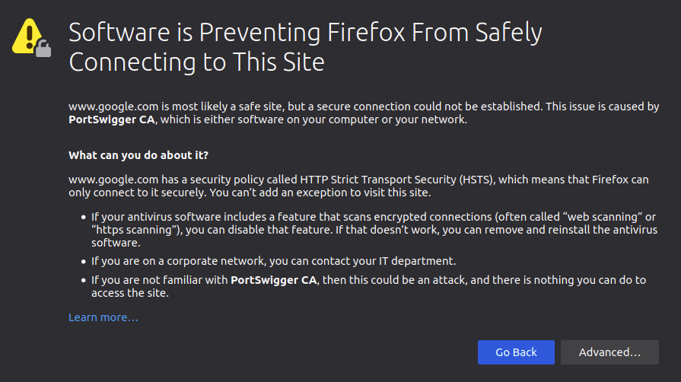
Installing Certificate:::::
http://burp/cert----download CA
about:preferences

Slide 13
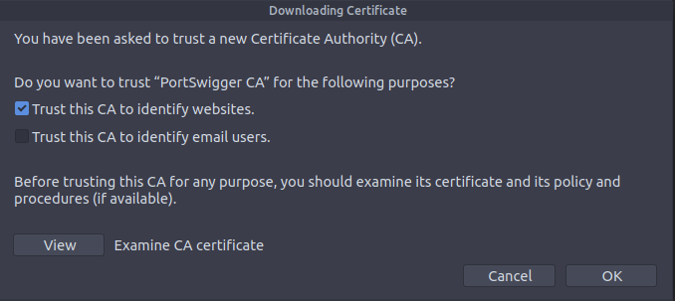
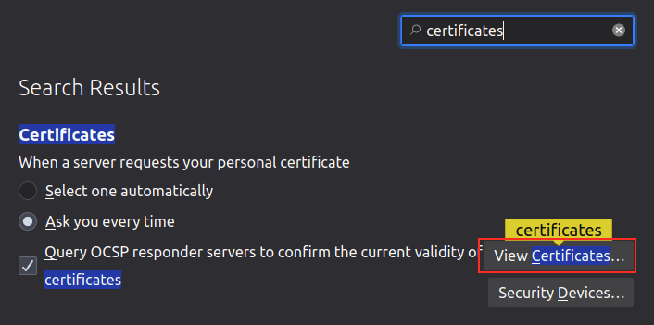
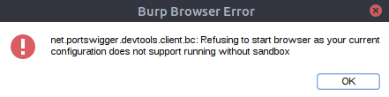

Slide 14
The smart option: We could create a new user and run Burp Suite under a low privilege account.
The easy option: We could go to Project options -> Misc -> Embedded Browser and check the Allow the embedded browser to run without a sandbox option.
Checking this option will allow the browser to start, but be aware that it is disabled by default for security reasons: if we get compromised using the browser, then an attacker will have access to our entire machine. On the training environment of the AttackBox this is unlikely (and isn't a huge issue even if it does happen), but keep it in mind if you try this on a local installation of Burp Suite.

Slide 15
Scoping and Targeting
It can get extremely tedious having Burp capturing all of our traffic. When it logs everything (including traffic to sites we aren't targeting), it muddies up logs we may later wish to send to clients. In short, allowing Burp to capture everything can quickly become a massive pain.
What's the solution? Scoping.
Setting a scope for the project allows us to define what gets proxied and logged. We can restrict Burp Suite to only target the web application(s) that we want to test. The easiest way to do this is by switching over to the "Target" tab, right-clicking our target from our list on the left, then choosing "Add To Scope". Burp will then ask us whether we want to stop logging anything which isn't in scope -- most of the time we want to choose "yes" here.

Slide 16
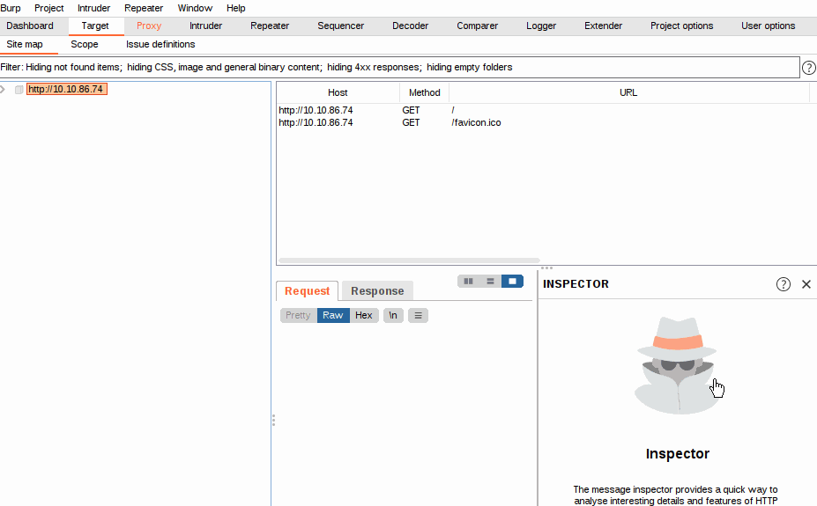

Slide 17
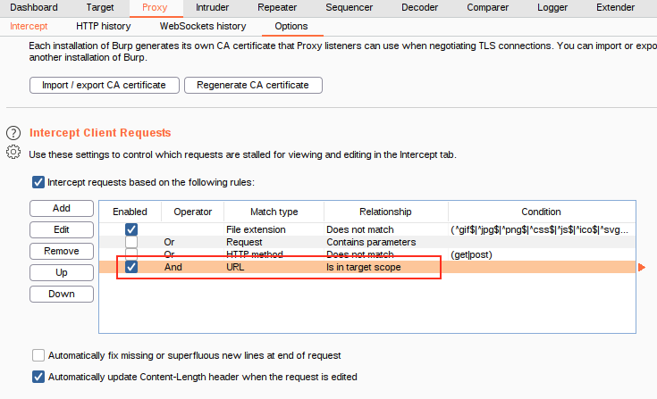

Slide 18
There are three sub-tabs under Target:
Site map allows us to map out the apps we are targeting in a tree structure. Every page that we visit will show up here, allowing us to automatically generate a site map for the target simply by browsing around the web app. Burp Pro would also allow us to spider the targets automatically (i.e. look through every page for links and use them to map out as much of the site as-is publicly accessible using the links between pages); however, with Burp Community, we can still use this to accumulate data whilst we perform our initial enumeration steps. The Site map can be especially useful if we want to map out an API, as whenever we visit a page, any API endpoints that the page retrieves data from whilst loading will show up here.
Scope: We have already seen the Scope sub-tab -- it allows us to control Burp's target scope for the project.
Issue Definitions: Whilst we don't have access to the Burp Suite vulnerability scanner in Burp Community, we do still have access to a list of all the vulnerabilities it looks for. The Issue Definitions section gives us a huge list of web vulnerabilities (complete with descriptions and references) which we can draw from should we need citations for a report or help describing a vulnerability.

Slide 19
Repeater
In short: Burp Suite Repeater allows us to craft and/or relay intercepted requests to a target at will. In layman's terms, it means we can take a request captured in the Proxy, edit it, and send the same request repeatedly as many times as we wish. Alternatively, we could craft requests by hand, much as we would from the CLI (Command Line Interface), using a tool such as cURL to build and send requests.
At the very top left of the tab, we have a list of Repeater requests. We can have many different requests.
Directly underneath the request list, we have the controls for the current request. These allow us to send a request, cancel a hanging request, and go forwards/backwards in the request history.
Still on the left-hand side of the tab, but taking up most of the window, we have the request and response view.
Above the request/response section, on the right-hand side, is a set of options allowing us to change the layout for the request and response views.
At the right-hand side of the window, we have the Inspector, which allows us to break requests apart to analyse and edit them in a slightly more intuitive way than with the raw editor.
Finally, above the Inspector we have our target. Quite simply, this is the IP address or domain to which we are sending requests.

Slide 20
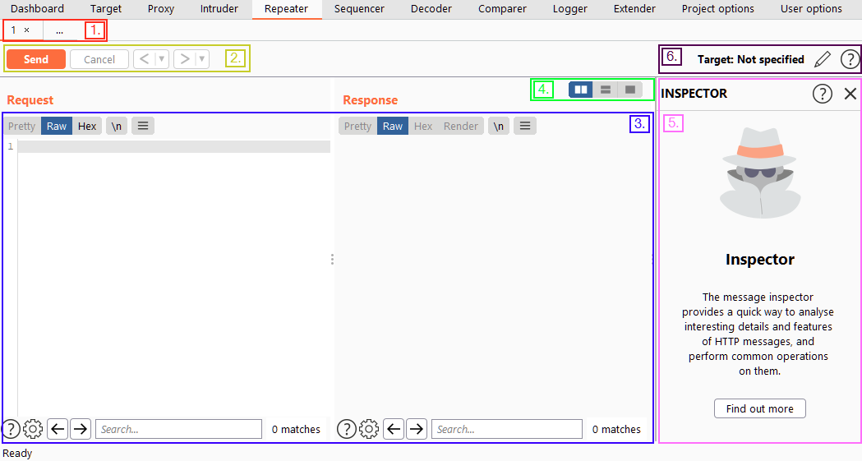

Slide 21
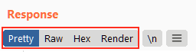
We have four display options here:
Pretty: This is the default option. It takes the raw response and attempts to beautify it slightly, making it easier to read.
Raw: The pure, un-beautified response from the server.
Hex: This view takes the raw response and gives us a byte view of it -- especially useful if the response is a binary file.
Render: The render view renders the page as it would appear in your browser. Whilst not hugely useful given that we would usually be interested in the source code when using Repeater, this is still a neat trick.
Just to the right of the view buttons is the "Show non-printable characters" button (\n). This button allows us to display characters that usually wouldn't show up in the Pretty or Raw views. For example, every line in the response will end with the characters \r\n -- these signify a carriage return followed by a newline and are part of how HTTP headers are interpreted.

Slide 22
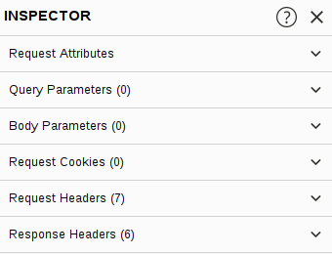
Query Parameters, which refer to data being sent to the server in the URL. For example, in a GET request to https://admin.tryhackme.com/?redirect=false, there is a query parameter called "redirect" with a value of "false".
Body Parameters, which do the same thing as Query Parameters, but for POST requests. Anything that we send as data in a POST request will show up in this section.
Request Cookies contain, as you may expect, a modifiable list of the cookies which are being sent with each request.
Request Headers allow us to view, access, and modify (including outright adding or removing) any of the headers being sent with our requests. Editing these can be very useful when attempting to see how a webserver will respond to unexpected headers.
Response Headers show us the headers that the server sent back in response to our request. These cannot be edited (as we can't control what headers the server returns to us!). Note that this section will only show up after we have sent the request and received a response.

Slide 23
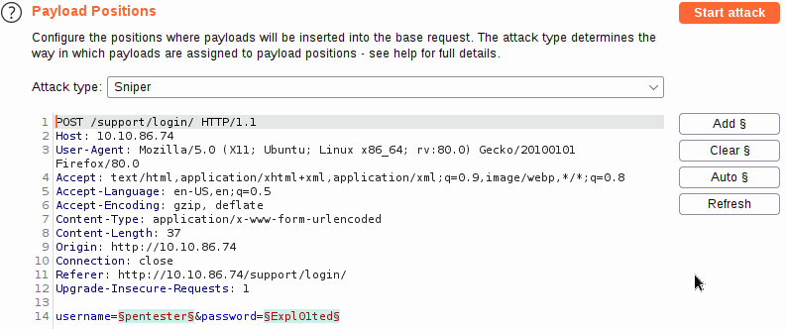
Burp Suite: Intruder
Intruder is Burp Suite's in-built fuzzing tool.Intruder allows us to automate requests, which is very useful when fuzzing or bruteforcing. We will be looking at how to use Intruder to perform both of these functions in conjunction with the other tools we have already covered.
When we are looking to perform an attack with Intruder, the first thing we need to do is look at positions. Positions tell Intruder where to insert payloads.

Slide 24
There are four attack types available:
Sniper
Battering ram
Pitchfork
Cluster bomb
Sniper
When conducting a sniper attack, we provide one set of payloads. For example, this could be a single file containing a wordlist or a range of numbers. From here on out, we will refer to a list of items to be slotted into requests using the Burp Suite terminology of a "Payload Set".
[ requests = numberOfWords * numberOfPositions ]
Battering ram
Like Sniper, Battering ram takes one set of payloads (e.g. one wordlist). Unlike Sniper, the Battering ram puts the same payload in every position rather than in each position in turn.

Slide 25
Pitchfork
After Sniper, Pitchfork is the attack type you are most likely to use. It may help to think of Pitchfork as being like having numerous Snipers running simultaneously. Where Sniper uses one payload set (which it uses on every position simultaneously), Pitchfork uses one payload set per position (up to a maximum of 20) and iterates through them all at once.
Cluster Bomb
Like Pitchfork, Cluster bomb allows us to choose multiple payload sets: one per position, up to a maximum of 20; however, whilst Pitchfork iterates through each payload set simultaneously, Cluster bomb iterates through each payload set individually, making sure that every possible combination of payloads is tested.

Slide 26
(Insecure Direct Object References) IDOR using Burp Intruder:
Looking at the URL, we can see that these pages are numbered, e.g.:
http://MACHINE_IP/support/ticket/NUMBER (http://10.0.10.91/support/ticket/3)
The numbering means that we know the tickets aren't being identified by hard-to-guess IDs -- they are simply assigned an integer identifier.
What happens if we use intruder to fuzz the/support/ticket/NUMBER endpoint? One of two things will happen:
The endpoint has been set up correctly only to allow us to view tickets that are assigned to our current user, or
The endpoint has not had the correct access controls set, which would allow us to read all of the existing tickets! If this is the case, then a vulnerability called an IDOR (Insecure Direct Object References) is present.
Let's try fuzzing this endpoint

Slide 27
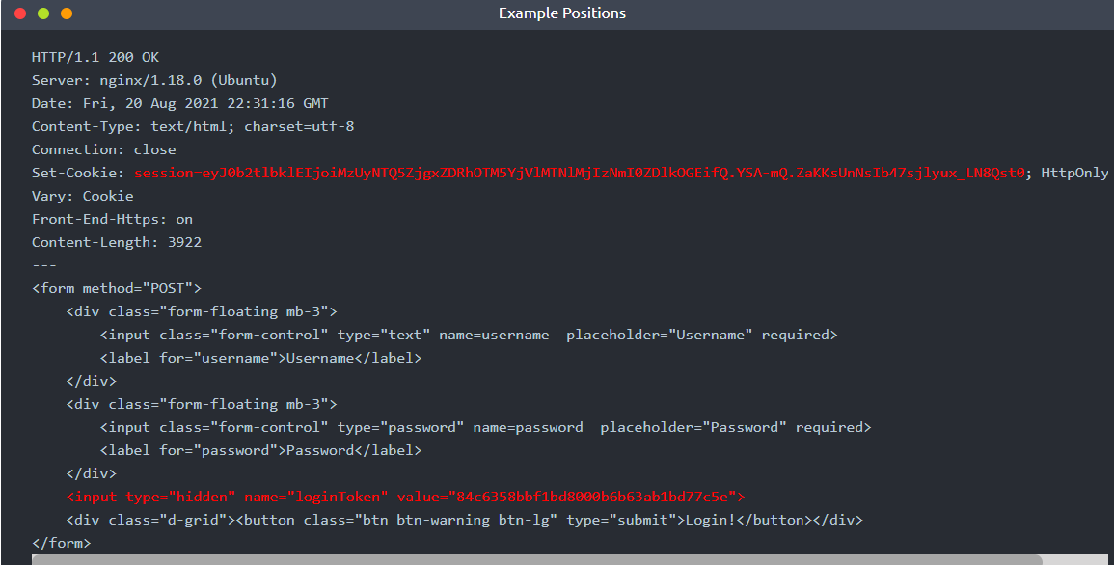
CSRF Token Bypass(Using Burp Intruder and macros)

Slide 28
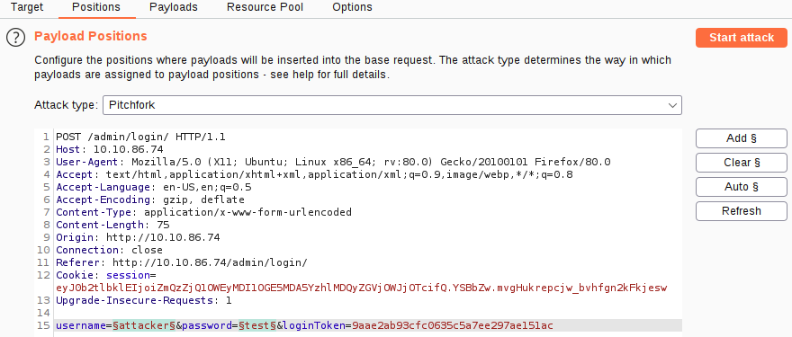
We have the same username and password fields as before, but now there is also a session cookie set in the response, as well as a CSRF (Cross-Site Request Forgery) token included in the form as a hidden field. If we refresh the page, we should see that both of these change with each request: this means that we will need to extract valid values for both every time we make a request.
In other words, every time we attempt to log in, we will need unique values for the session cookie and loginToken hidden form input.
Configure the positions the same way as we did for bruteforcing the support login:
Set the attack type to be "Pitchfork".
Clear all of the predefined positions and select only the username and password form fields. The other two positions will be handled by our macro.

Slide 29
With the username and password parameters handled, we now need to find a way to grab the ever-changing loginToken and session cookie.
Macros allow us to perform the same set of actions repeatedly. In this case, we simply want to send a GET request to /admin/login/
Fortunately, setting this up is a very easy process.
Switch over to the "Project Options" tab, then the "Sessions" sub-tab.
Scroll down to the bottom of the sub-tab to the "Macros" section and click the "Add" button.
The menu that appears will show us our request history. If there isn't a GET request to http://MACHINE_IP/admin/login/ in the list already, navigate to this location in your browser and you should see a suitable request appear in the list.
With the request selected, click Ok.
Finally, give the macro a suitable name, then click "Ok" again to finish the process.
There are a lot of steps here, comparatively speaking, so the following GIF shows the ent

Slide 30
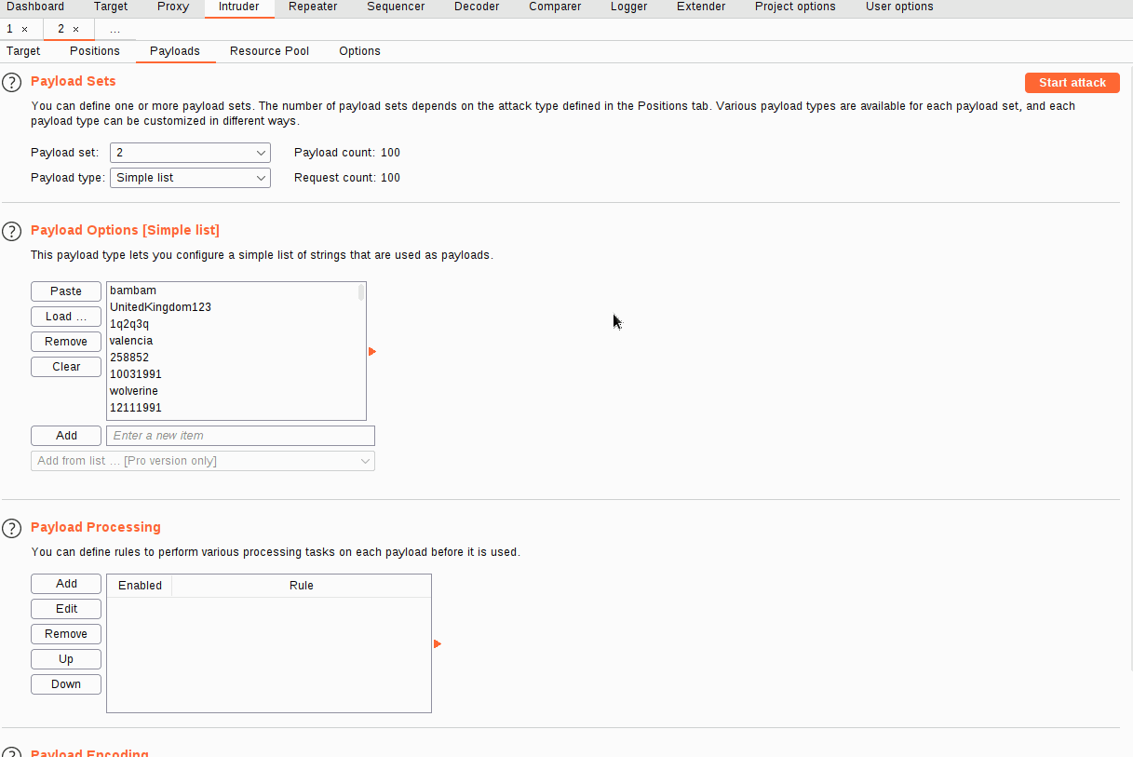

Slide 31
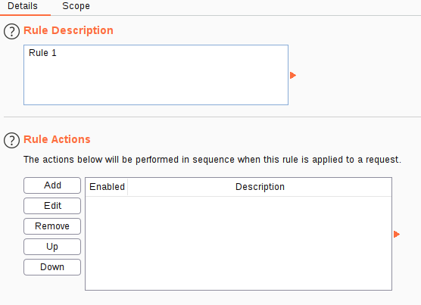
Now that we have a macro defined, we need to set Session Handling rules that define how the macro should be used.
Still in the "Sessions" sub-tab of Project Options, scroll up to the "Session Handling Rules" section and choose to "Add" a new rule.
A new window will pop up with two tabs in it: "Details" and "Scope". We are in the Details tab by default

Slide 32
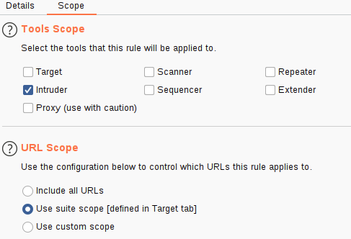
3. Fill in an appropriate description, then switch over to the Scope tab.
4. In the "Tools Scope" section, deselect every checkbox other than Intruder -- we do not need this rule to apply anywhere else.
5. In the "URL Scope" section, choose "Use suite scope"; this will set the macro to only operate on sites that have been added to the global scope (as was discussed in Burp Basics). If you have not set a global scope, keep the "Use custom scope" option as default and add http://MACHINE_IP/ to the scope in this section.

Slide 33
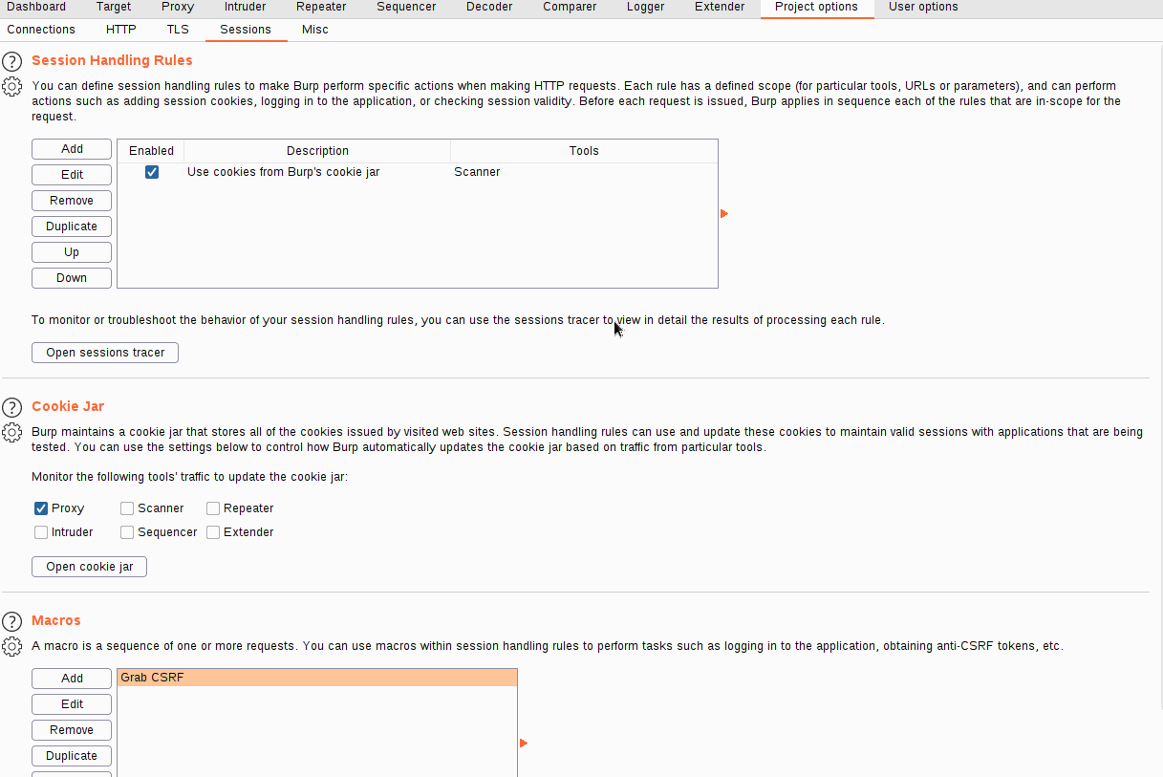

Slide 34
Now we need to switch back over to the Details tab and look at the "Rule Actions" section.
Click the "Add" button -- this will cause a dropdown menu to appear with a list of actions we can add.
Select "Run a Macro" from this list.
In the new window that appears, select the macro we created earlier.
Select "Update only the following parameters", then click the "Edit" button next to the input box below the radio button.
In the "Enter a new item" text field, type "loginToken". Press "Add", then "Close".
Select "Update only the following cookies", then click the relevant "Edit" button.
Enter "session" in the "Enter a new item" text field, press "Add", then "Close".
Finally, press "Ok" to confirm our action.

Slide 35
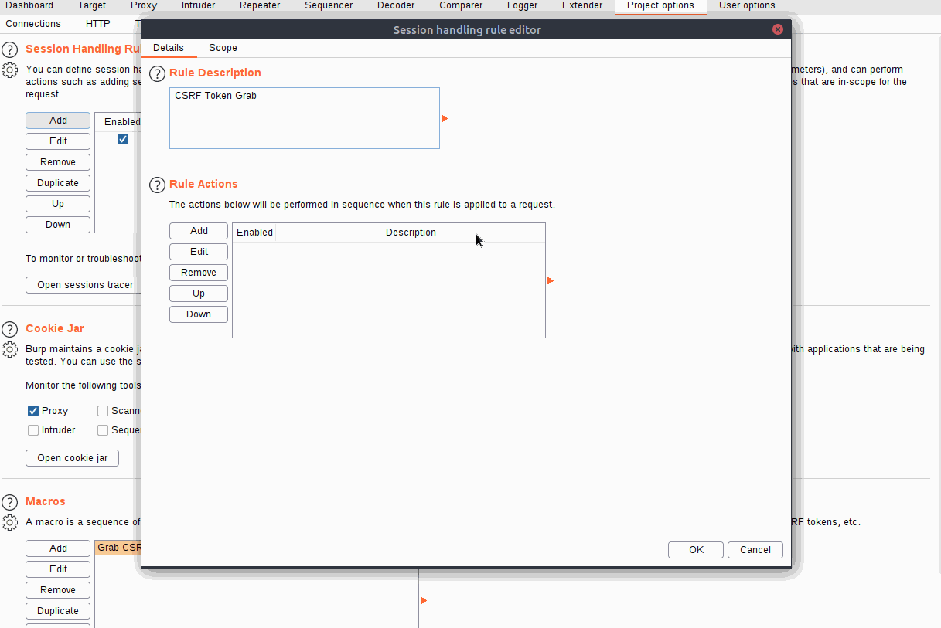

Slide 36
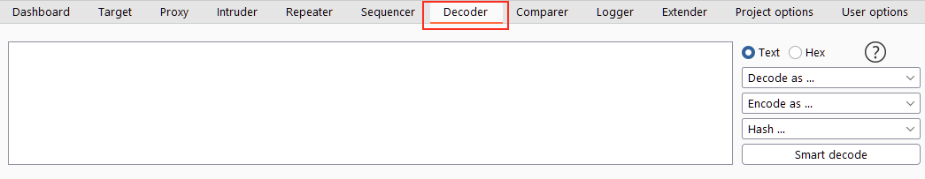
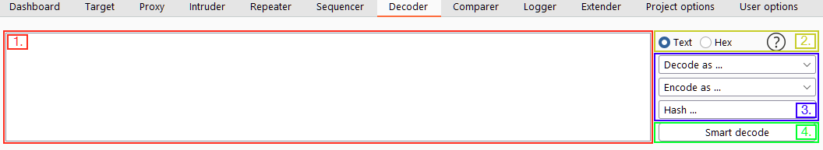
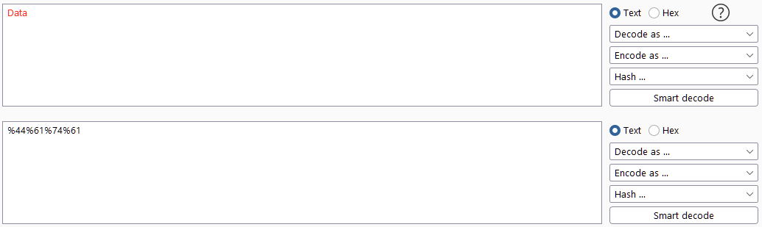
Decoder:
The Burp Suite Decoder module allows us to manipulate data. As the name suggests, we can decode information that we capture during an attack, but we can also encode data of our own, ready to be sent to the target. Decoder also allows us to create hashsums of data, as well as providing a Smart Decode feature which attempts to decode provided data recursively until it is back to being plaintext (like the "Magic" function of Cyberchef).

Slide 37
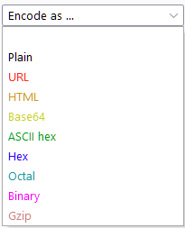
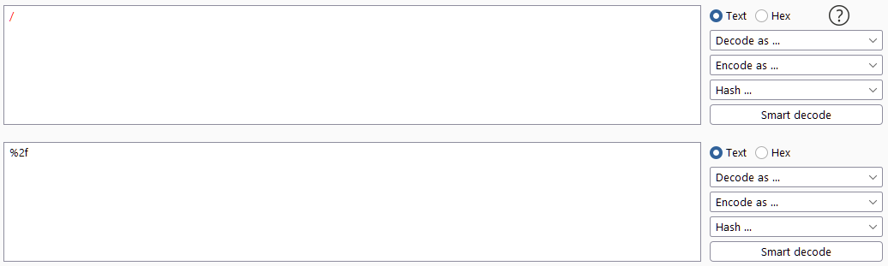
Decoding/Encoding Methods:
Let's take a closer look at the manual encoding and decoding options. These are the same whether we choose the decoding or encoding menu:
Plain: Plaintext is what we have before performing any transformations.
URL: URL encoding is used to make data safe to transfer in the URL of a web request. It involves exchanging characters for their ASCII character code in hexadecimal format, preceded by a percentage symbol (%). Url encoding is an extremely useful method to know for any kind of web application testing.
For example, let's encode the forward-slash character (/). The ASCII character code for a forward slash is 47. This is "2F" in hexadecimal, making the URL encoded forward-slash %2F. We can confirm this with Decoder by typing a forward slash in the input box, then selecting Encode as -> URL:

Slide 38
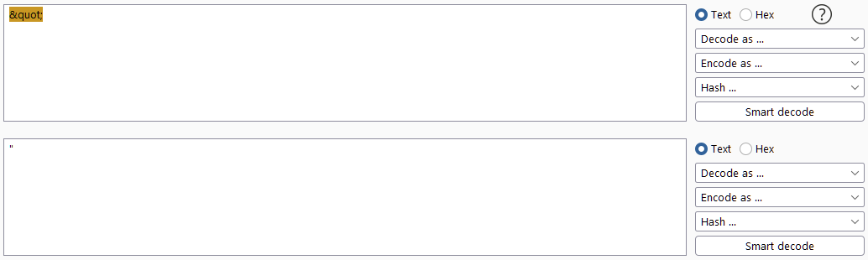
HTML: Encoding text as HTML Entities involves replacing special characters with an ampersand (&) followed by either a hexadecimal number or a reference to the character being escaped, then a semicolon (;). For example, a quotation mark has its own reference: &quot;. When this is inserted into a webpage, it will be replaced by a double quotation mark ("). This encoding method allows special characters in the HTML language to be rendered safely in HTML pages and has the added bonus of being used to prevent attacks such as XSS (Cross-Site Scripting).
Base64: Another widely used encoding method, base64 is used to encode any data in an ASCII-compatible format. It was designed to take binary data (e.g. images, media, programs) and encode it in a format that would be suitable to transfer over virtually any medium.
Working Process: https://stackabuse.com/encoding-and-decoding-base64-strings-in-python/

Slide 39
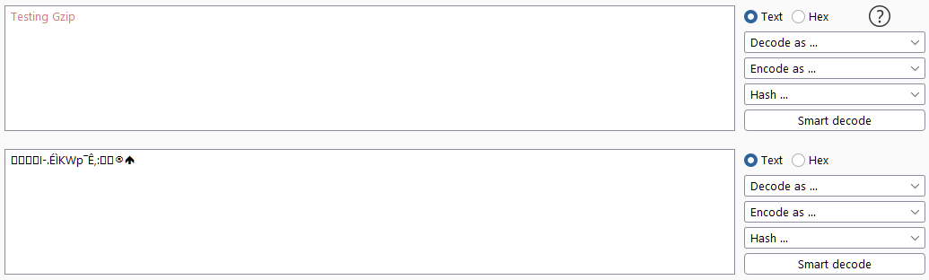
Gzip: Gzip provides a way to compress data. It is widely used to reduce the size of files and pages before they are sent to your browser. Smaller pages mean faster loading times, which is highly desirable for developers looking to increase their SEO score and avoid annoying their customers. Decoder allows us to manually encode and decode gzip data, although this can be hard to process as it is often not valid ASCII/Unicode. For example:

Slide 40
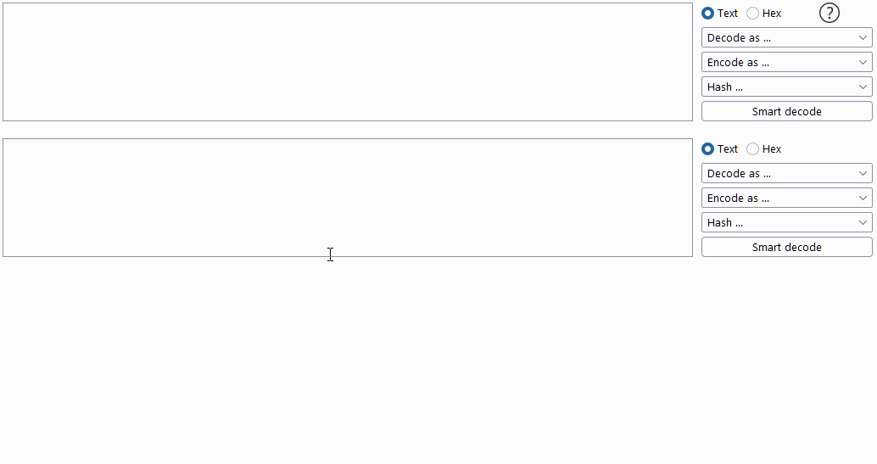

Slide 41
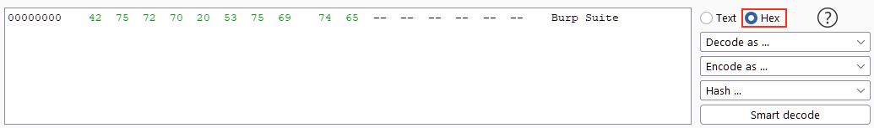
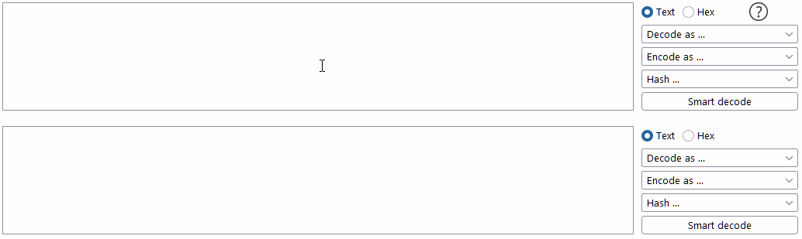
Inputting data in ASCII format is great, but sometimes we need to be able to edit our input byte-by-byte. For this, we can use "Hex View" by choosing "Hex" above the decoding options
Smart Decode:

Slide 42
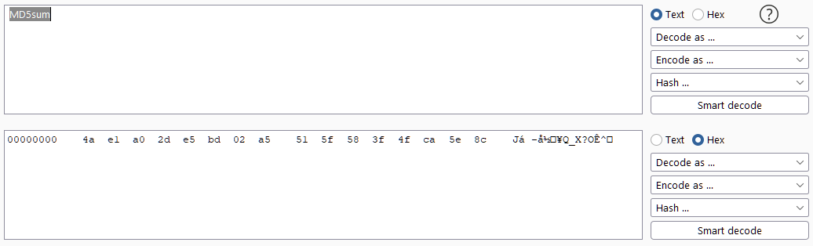
Decoder Hashing
Hashing is a one-way process that is used to transform data into a unique signature. To be a hashing algorithm, the resulting output must be impossible to reverse. A good hashing algorithm will ensure that every piece of data entered will have a completely unique hash.MD5sum and MD5SUM has totally diferent hash. For this reason, hashes are frequently used to verify the integrity of files and documents, as even a very small change to the file will result in the hashsum changing significantly.
Continuing our earlier example, let's enter "MD5sum" into the input box, then scroll down the list until we find "MD5". Applying this sends us automatically into the Hex view:

Slide 43
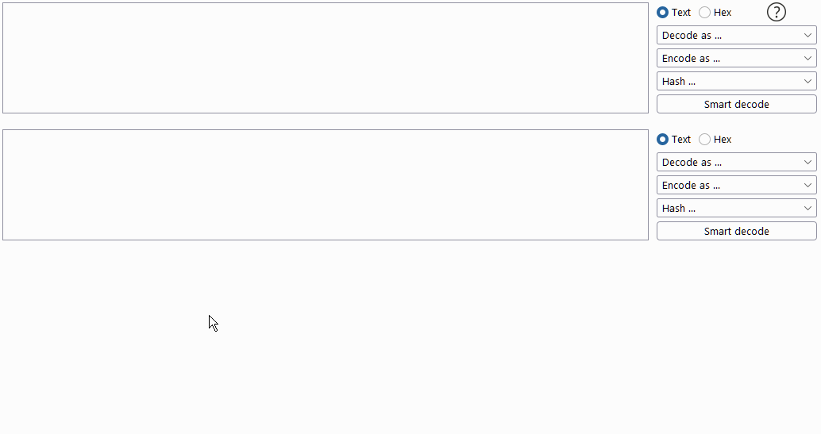
This is because the output of a hashing algorithm does not return pure ASCII/Unicode text. As such, it is common to take the resultant output of the algorithm and turn it into a hexadecimal string; this is the form of "hash" that you may be familiar with.
Let's finish this by applying an "ASCII Hex" encoding to the hashsum to create the neat hex string from our initial example.

Slide 44
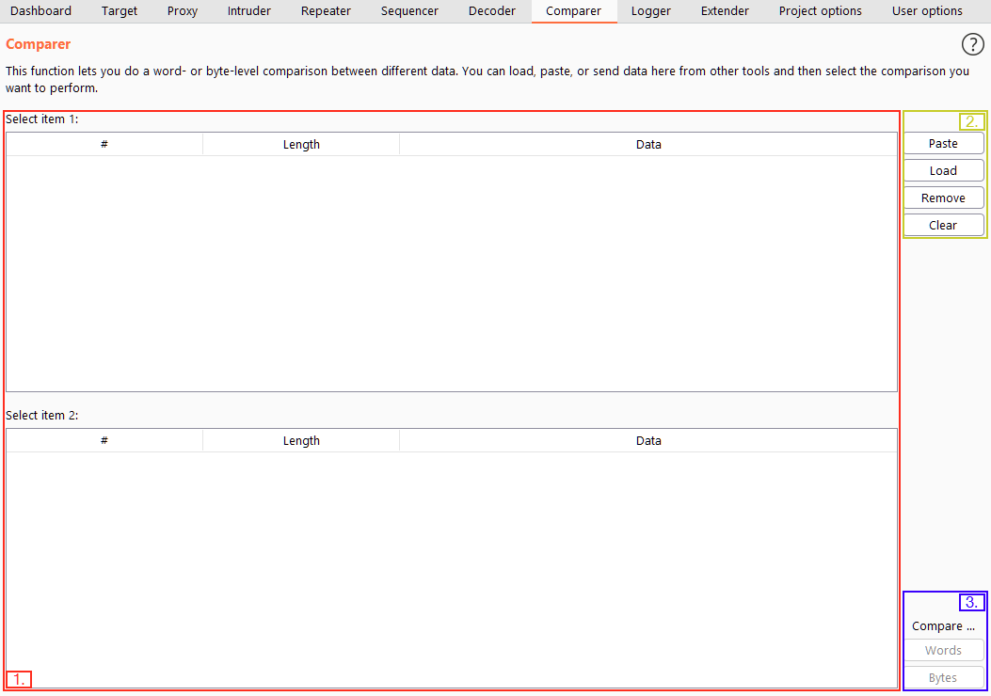
Comparer Overview
As the name suggests, Comparer allows us to compare two pieces of data, either by ASCII words or by bytes.

Slide 45
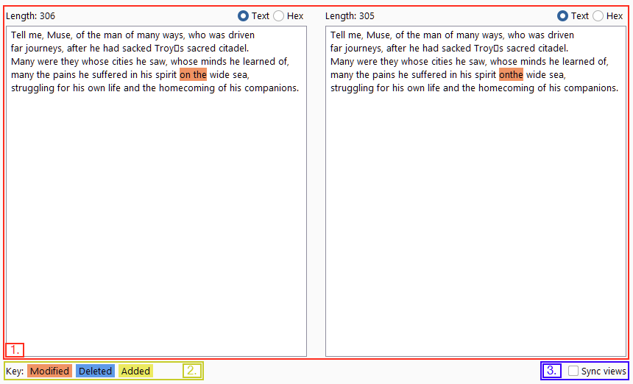
As with most Burp Suite modules, we can also load data into Comparer from other modules by right-clicking and choosing "Send to Comparer". When we have loaded data in to compare, we get a pop-up window showing us the comparison:

Slide 46
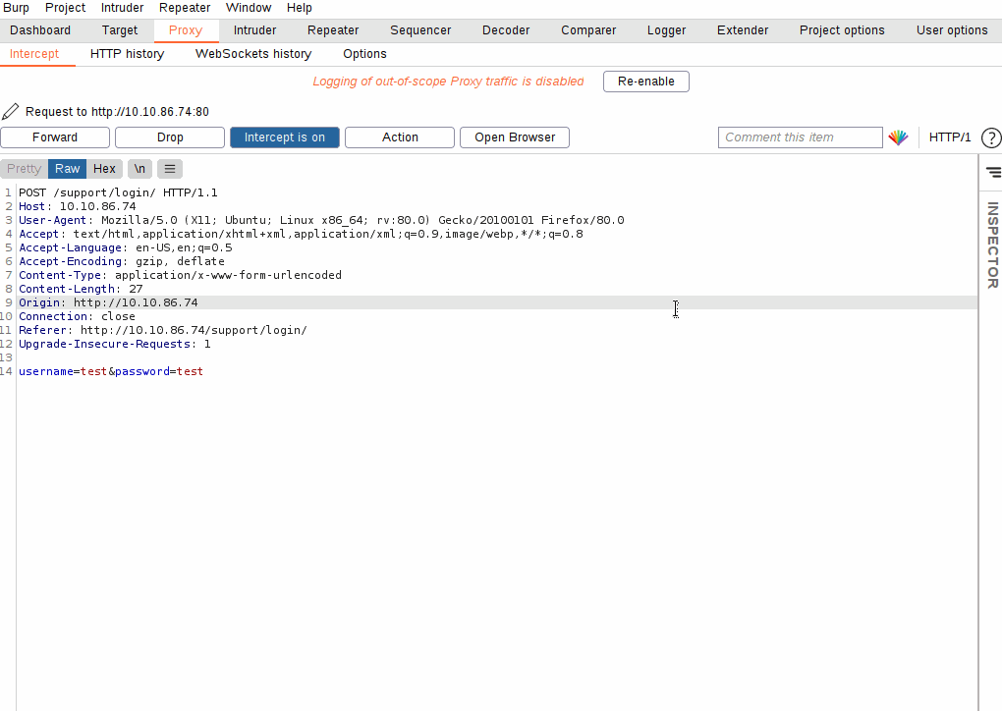
There are many situations where being able to quickly compare two (potentially very large) pieces of data can come in handy.
For example, when performing a login bruteforce or credential stuffing attack with Intruder, you may wish to compare two responses with different lengths to see where the differences lie and whether the differences indicate a successful login.

Slide 47
Sequencer Overview:
Sequencer is one of those tools that rarely ever gets used in CTFs and other lab environments but is an essential part of a real-world web app penetration test.
In short, Sequencer allows us to measure the entropy (or randomness, in other words) of "tokens" -- strings that are used to identify something and should, in theory, be generated in a cryptographically secure manner. For example, we may wish to analyse the randomness of a session cookie or a Cross-Site Request Forgery (CSRF) token protecting a form submission. If it turns out that these tokens are not generated securely, then we can (in theory) predict the values of upcoming tokens. Just imagine the implications of this if the token in question is used for password resets..
There are two main methods we can use to perform token analysis with Sequencer:
Live capture is the more common of the two methods -- this is the default sub-tab for Sequencer. Live capture allows us to pass a request to Sequencer, which we know will create a token for us to analyse. For example, we may wish to pass a POST request to a login endpoint into Sequencer, as we know that the server will respond by giving us a cookie. With the request passed in, we can tell Sequencer to start a live capture: it will then make the same request thousands of times automatically, storing the generated token samples for analysis. Once we have accumulated enough samples, we stop Sequencer and allow it to analyse the captured tokens.
Manual load allows us to load a list of pre-generated token samples straight into Sequencer for analysis. Using Manual Load means we don't have to make thousands of requests to our target (which is both loud and resource intensive), but it does mean that we need to obtain a large list of pre-generated tokens!

Slide 48
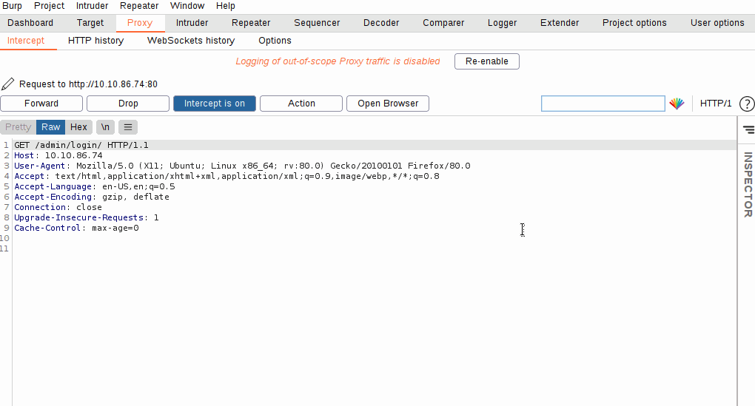

Slide 49
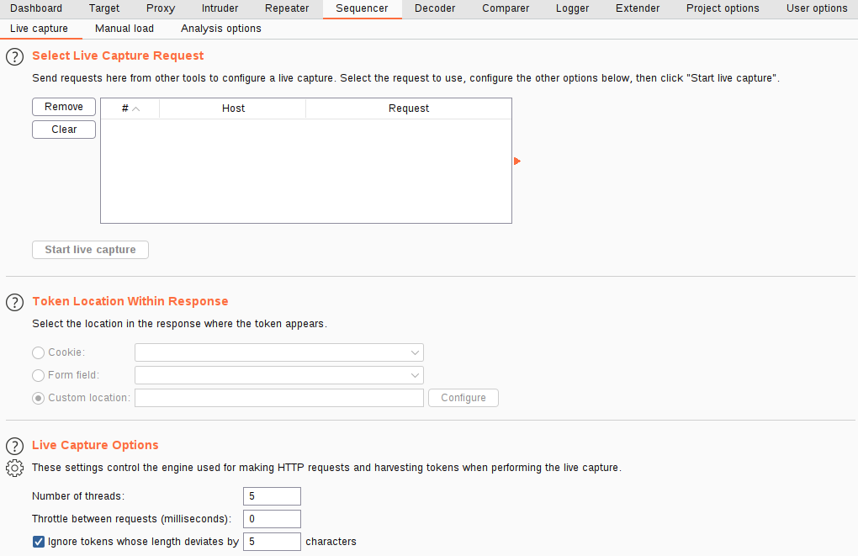

Slide 51
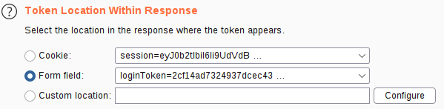
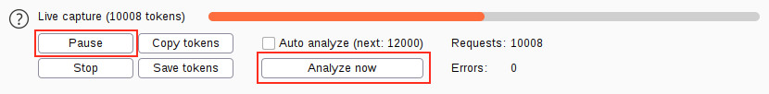

Slide 52
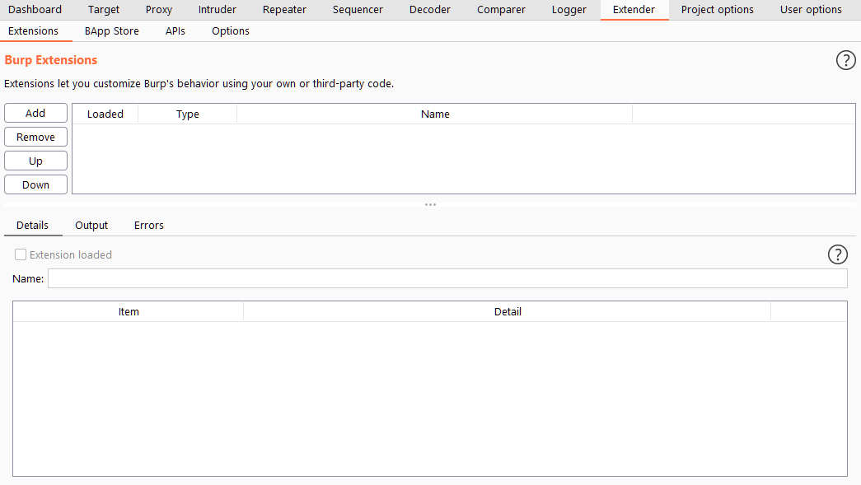
Extender
The default view in the Extender interface gives us an overview of the extensions that we have loaded into Burp Suite. The first box (towards the top of the interface) provides us with a list of extensions that we have installed and allows us to activate or deactivate them for this project.

Slide 53
Extender The BApp Store;
The Burp App Store (or BApp Store for short) gives us a way to easily list official extensions and integrate them seamlessly with Burp Suite. Extensions can be written in a variety of languages -- most commonly Java (which integrates into the framework automatically) or Python (which requires the Jython interpreter)
The Request Timer extension (Written by Nick Taylor) allows us to log the time that each request we send takes to receive a response; this can be extremely useful for discovering the presence of (and exploiting) time-based vulnerabilities. For example, if a login form takes an extra second to process requests that contain a valid username than it does for accounts that do not exist, then we can quickly generate a list of possible usernames and use the difference in times to see which usernames are valid.

Slide 54
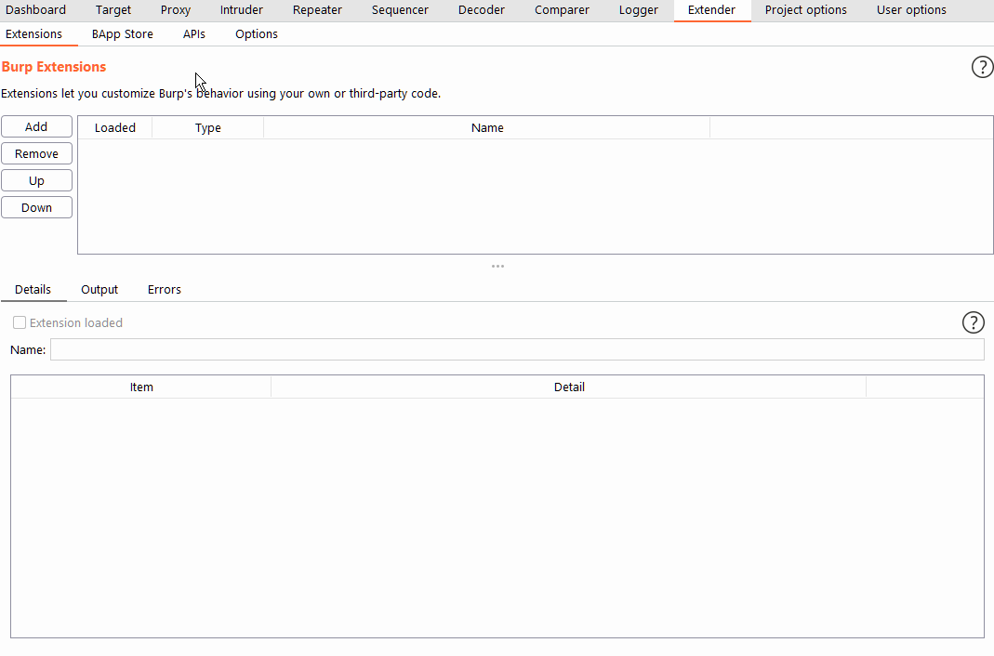

Slide 55
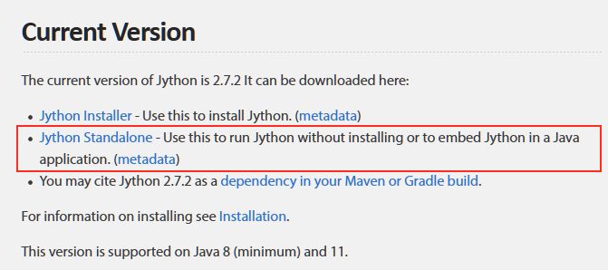
Extender Jython
If we want to use Python modules in Burp Suite, we need to have downloaded and included the separate Jython Interpreter JAR file. The Jython interpreter is a Java implementation of Python. The website gives us the option to either install Jython to our system or download it as a standalone Java archive (JAR). We need it as a standalone archive to integrate it with Burp.
Jpython link: https://www.jython.org/download
Save the JAR file somewhere on your disk, then switch to the "Options" sub-tab in Extender.
Scroll down to the "Python Environment" section, and set the "Location of Jython standalone JAR file" to the path of the archive:

Slide 56
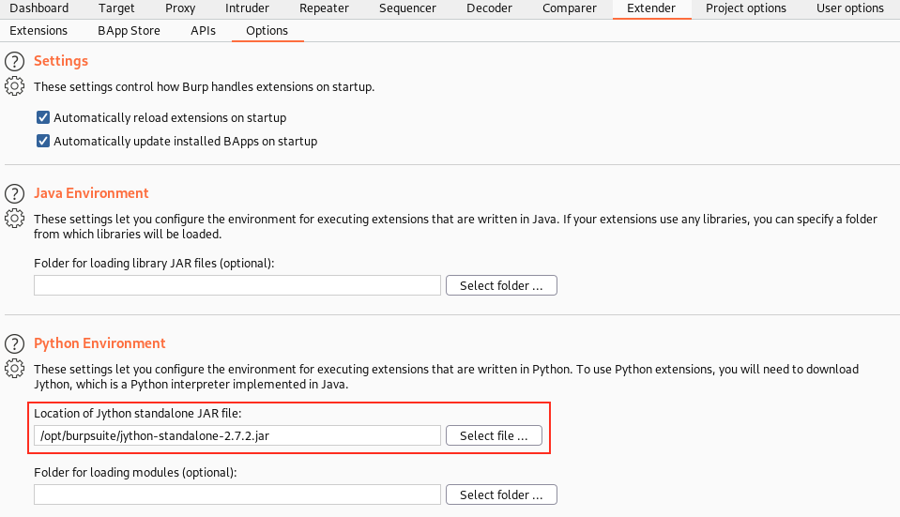

Slide 57
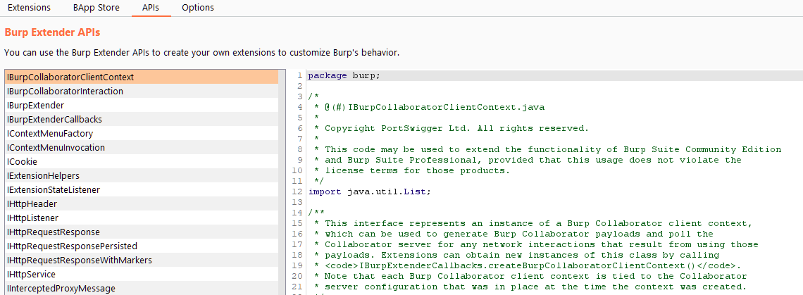
Extender The Burp Suite API
Extender exposes a large number of API Endpoints that new modules can hook into when integrating with Burp Suite.

